Slide 1




Machine Learning for beginners

Slide 2
What are Artificial Intelligence and Machine Learning?
Definition: Artificial Intelligence (AI) refers to the simulation of human intelligence in machines.
Goal: Enable machines to think, reason, and act.
Main Capabilities:
Problem-solving
Decision-making
Language understanding
Learning
The term Artificial Intelligence – first introduced in 1956 at the Dartmouth Conference, which is considered the official starting point of AI as aresearch field.
Types of AI:
Narrow AI (weak AI): Performs specific tasks
General AI (strong AI): Hypothetical – human-level reasoning across domains (not achieved)

Slide 3
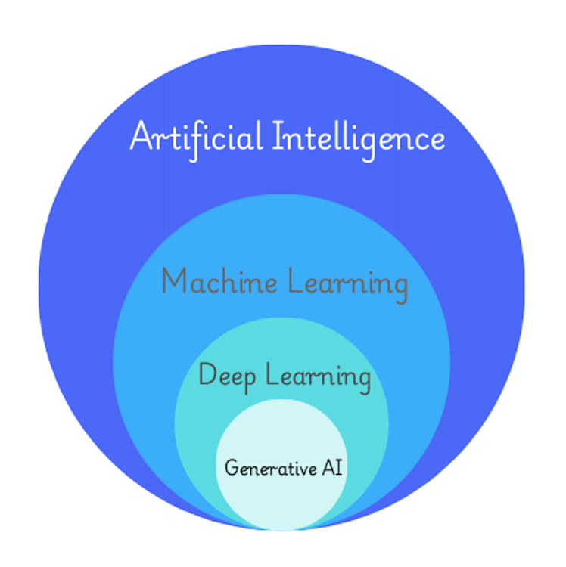
Machine Learning
AI encompasses a wide range of techniques like:
Rule-based systems
Expert systems
Robotics
Machine learning (ML)
ML – Machine Learning:
A subset of AI
Focuses on learning from data to improve performance over time
Models are trained to recognize patterns and make predictions
DL – Deep Learning:
A subset of ML
Uses artificial neural networks or deep neural networks
Generative AI:
A subfield of DL
Focuses on creating new content (text, images, audio, etc.) that resembles training data

Slide 4
How Machine Learning Works?
ML systems learn from examples, not rules.
It learns by optimizing mathematical functions.
It uses statistics to understand correlations, trends, and distributions.
It applies mathematical rules to update model parameters.
The result is a trained model that can perform generalization to new, unseen data.
Especially powerful in dynamic, real-world problems.
In conventional programming, humans define all the rules explicitly.
To identify images of cats:
Conventional programming: requires detailed rules about fur, texture, ear shapes
Machine Learning: by processing many images of cats, the system uses mathematical functions to learn the patterns

Slide 5
Types of ML
Earthquake Hotspots
Document Organization
Disease diagnosis
Fraud detection
Image Segmentation
Speech recognition
Customer Segmentation
Genomic Visualization
Clustering
Spam detection
Sentiment analysis
Classification
Image Compression
Medical Imaging
Semi supervised Learning
Dimensionality Reduction
Text classification
House pricing
Anomaly Detection
Gene prediction
Supervised Learning
Unsupervised Learning
Machine Learning
Stock prediction
Behavior Mapping
Regression
Density Estimation
Age Analysis
Income Distribution
Sales estimation
Energy forecasting
Height Estimation
Star Classification
Industrial Automation
Autonomous Vehicles
Reinforcement Learning
Game Playing
Robotics Control
Personalized Recommendations

Slide 6


Supervised Learning
Supervised learning: the algorithm is trained on a labeled dataset;
The each input data point is paired with the correct output;
Labeled data
Output
Prediction
square
star
circle
triangle
Model Training
Labels
star
triangle
circle
square
Test Data

Slide 7

Unsupervised Learning
Unlabeled data
Algorithms
Interpretation
Processing
Outputs

Slide 8
Large amount of unlabeled data
Semi-Supervised Learning
Pseudo-labeled dataset
Predictions
It will be either a square or
a triangle or
a star or
a circle
Machine Learning Model
ML model trained on Pseudo-labeled data and labeled data
Small amount of labeled data
star
triangle
circle
square
Data to be predicted
Four different groups are identified. The outputs have labels
Trained ML model

Slide 9
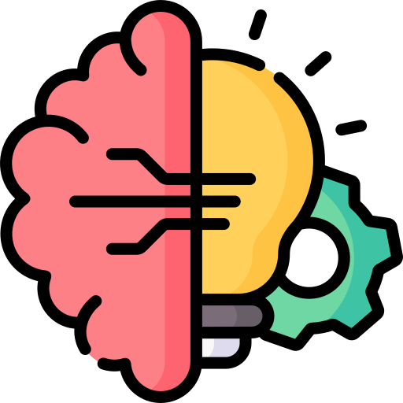
Reinforcement Learning
Environment
Input Raw Data
Reward
Best Action
Selection of Algorithm
State
Agent

Slide 10


Machine Learning Workflow
Raw Dataset
Feature extraction
Model Training
Predictions
Exploratory Data Analysis
Interpretation
Model Evaluation

Slide 11
Dataset
A collection of data points used to train and evaluate ML models;
Multiple samples each containing a set of features;
Training, Testing, and Validation dataset
Splitting strategy: 80% train & 20% test | or 70% train, 15% test & 15% validation
Training Dataset
The largest portion of the dataset
Used to train the model
It helps the model learn patterns, relationships, and dependencies
Large and diverse enough to generalize well
Must be representative
Contains features (inputs) and labels (outputs)
Test Dataset
The portion of data used to evaluate the final performance of a trained ML model
Simulates real-world data
Independent of the training data
Representative
Labels are available but never used during training
Validation Dataset
Used for tuning hyperparameters & model selection
Helps to optimize the model before final testing
Helps prevent overfitting
Should be similar to the test set for accurate tuning

Slide 12










Exploratory Data Analysis (EDA)
The crucial step in the ML pipeline
It is important to understand the structure, distribution, and relationship within the dataset before training ML models.
Helps identify missing values, detect outliers, and reveal patterns that could influence model performance
Language Environment | Python | R | SQL | Julia | Apache Spark | MATLAB
Jupyter notebook
Google Colab
VS Code
RStudio
Apache Zeppelin
MATLAB Live Editor

Slide 13
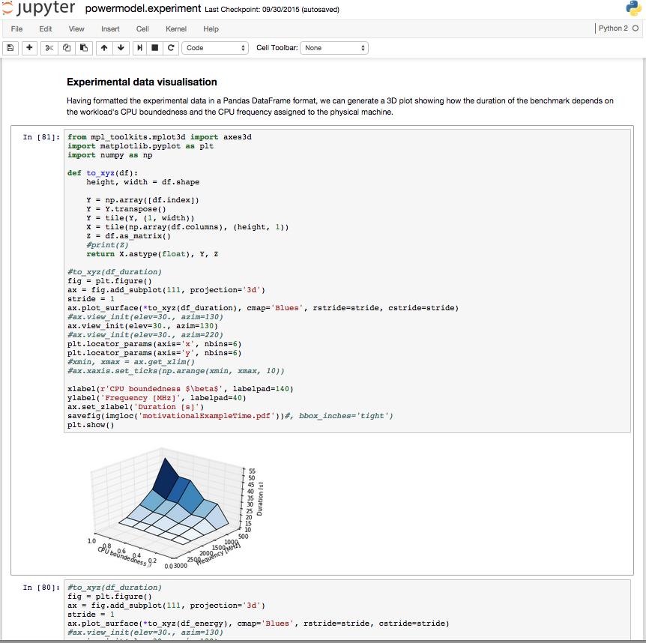
Jupyter Notebook
Jupyter notebook is an open-source, interactive computing tool
A document-style format
Running individual code cell independently – easier to test and debug snippets of code
Especially useful for data analysis and ML – allows users to iteratively explore data, generate plots, and refine preprocessing steps
The ability to mix code, markdown text, and visualizations in one document

Slide 14

Machine Learning Workflow
Raw Dataset
Feature extraction
Model Training
Predictions
Exploratory Data Analysis
Interpretation
Model Evaluation

Slide 15
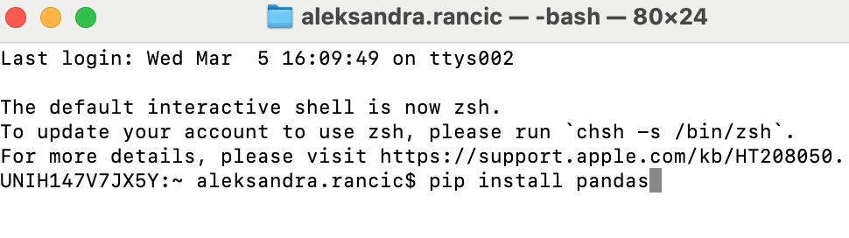
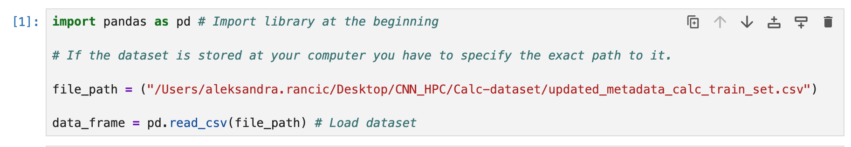
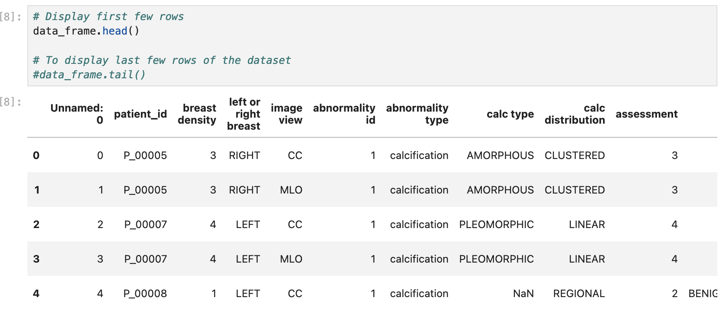
Exploratory Data Analysis (EDA) – Pandas
Data manipulation & analysis
Load datasets from various sources (CSV, Excel, SQL, etc.)
Clean missing values, filter data, compute descriptive statistics
Features
Samples
Missing value

Slide 16
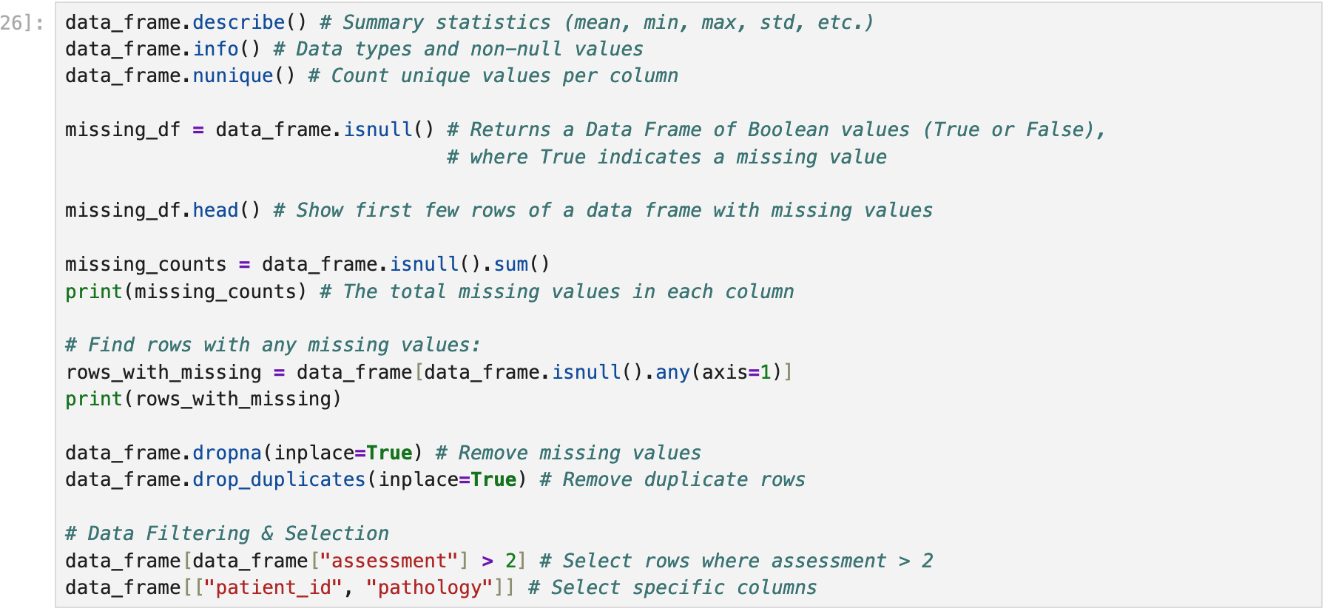
Exploratory Data Analysis (EDA)
Your turn:
Load dataset
Show first/last 10 columns
Explore data types
Explore summary statistics
Check unique values
Check if you have missing values and remove them
Check if you have duplicates

Slide 17
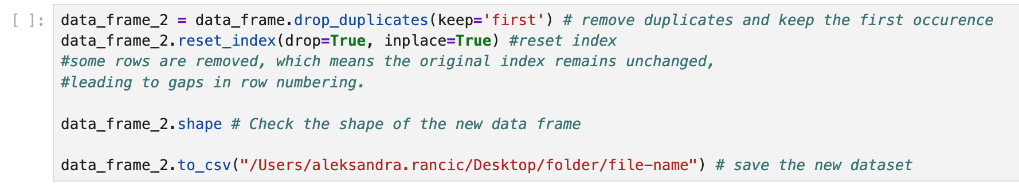
Exploratory Data Analysis (EDA)
Your turn:
Drop duplicates and keep the first occurrence
Reset indexing
Check how many columns and rows is in the new dataframe
Save the new dataframe as CSV file

Slide 18
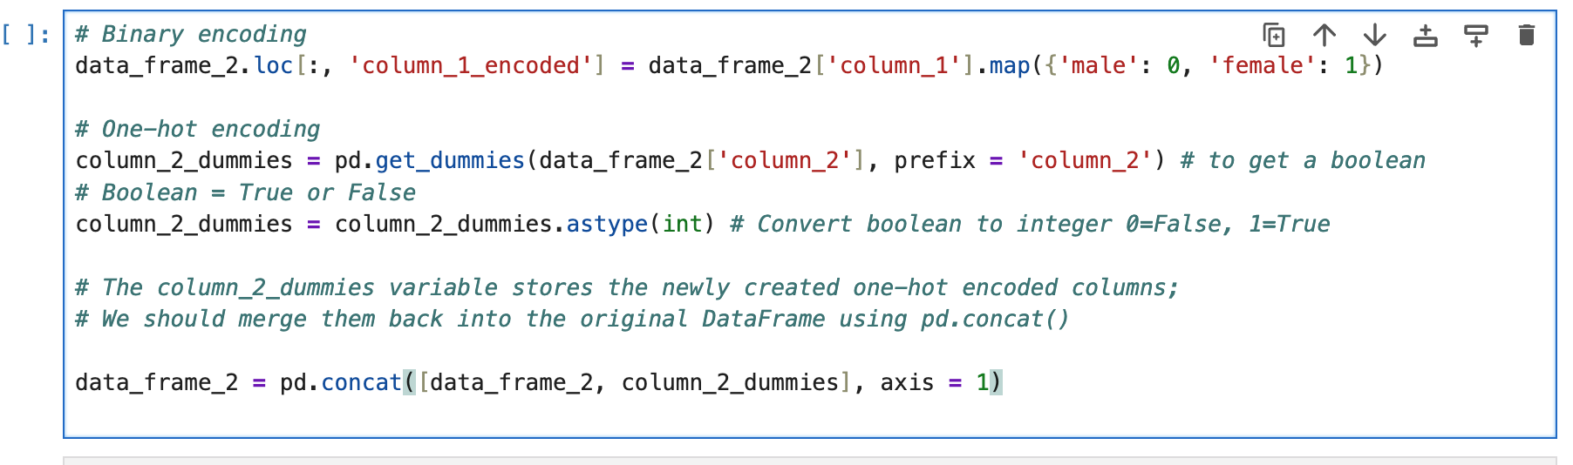
Exploratory Data Analysis (EDA)
When working with ML models, we must convert categorical variables into numerical values.
Traditional ML models cannot process text-based data.
This process is called encoding:
Binary encoding = converts categories into 0 and 1; Works if we have 2 categories
One-Hot encoding = creates new columns (dummy variables) for each category; This is used when we cannot assign numbers directly because it would mislead the model into thinking there is an order; Instead we create separate columns for each region.
Your turn:
Apply Binary encoding where possible
Apply One-hot encoding where needed
Merge hot-encoded columns back to DataFrame
Show first 10 rows of a new DataFrame

Slide 19
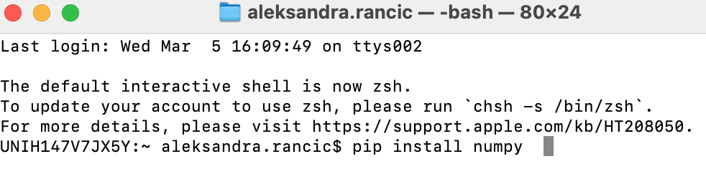
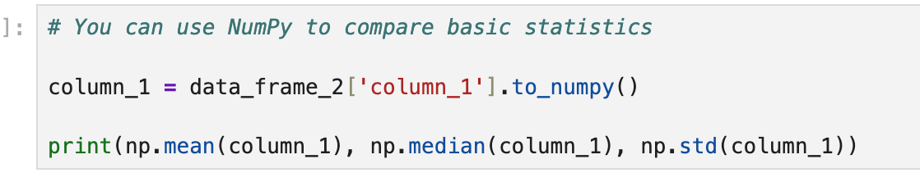
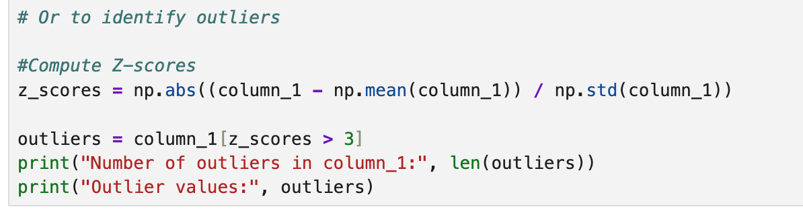
Exploratory Data Analysis (EDA) - NumPy
NumPy is a numerical computing library in Python
It provides support for arrays, matrices, and high-performance mathematical operations

Slide 20
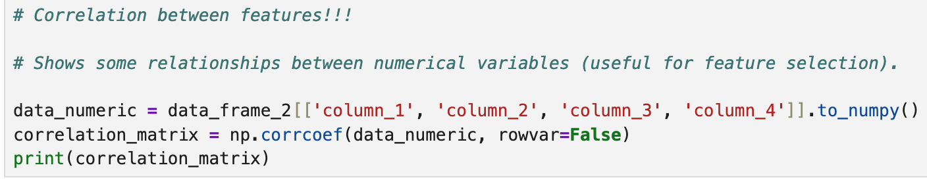
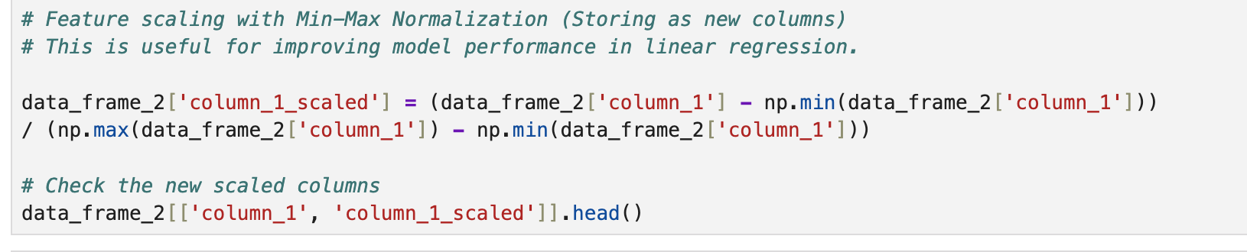
Exploratory Data Analysis (EDA) - NumPy
Your turn:
Use NumPy to calculate basic statistics
… to identify outliers
Investigate correlation between numeric features
Apply Min-Max Normalization where needed
Scaling is important because ensures fair comparison between features;
Without scaling, larger values dominate smaller ones, affecting model performance;

Slide 21
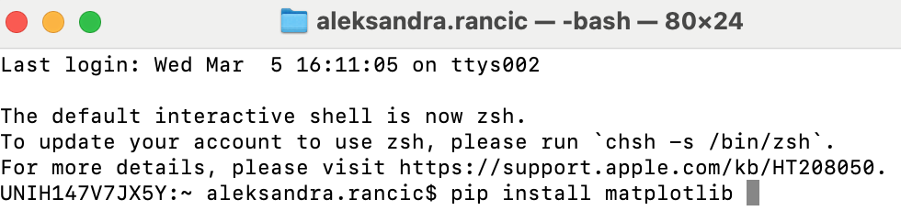
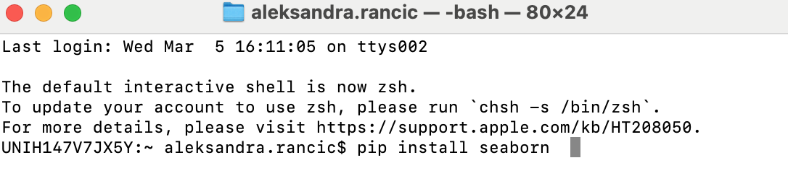
Exploratory Data Analysis – Visualization with Matplotlib and Seaborn
Matplotlib is a library for creating static, animated, and interactive visualizations.
Line-plots, histograms, scatter plots, bar charts to analyze trends in data
Seaborn is built on top of Matplotlib
Specifically designed for statistical data visualization
Box plots, violin plots, pair plots, heatmaps

Slide 22
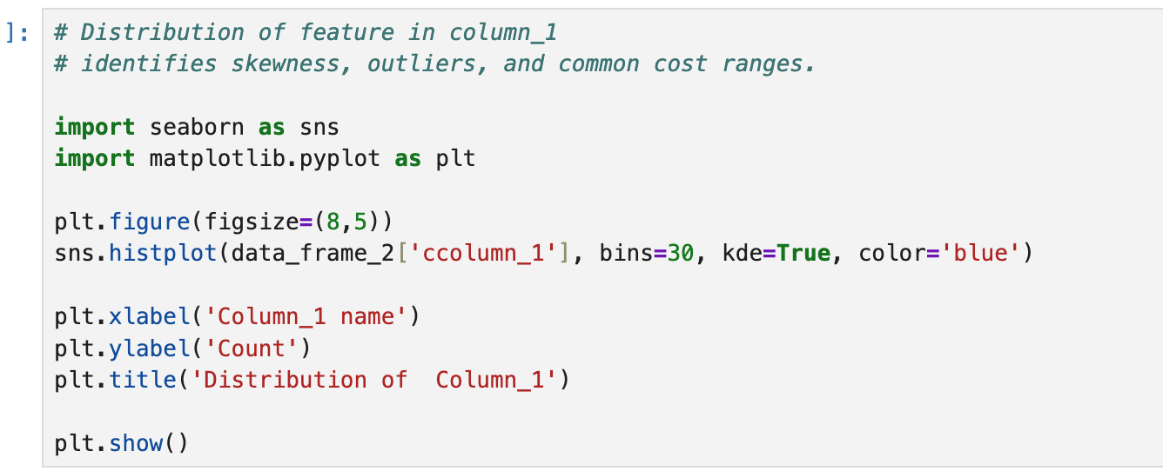
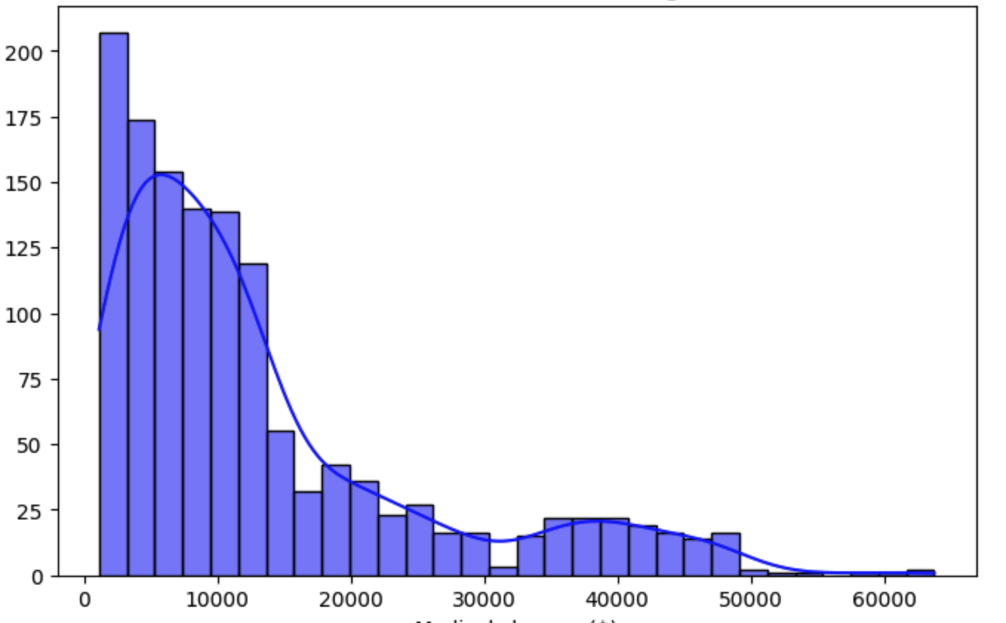
Count
Column_1 name

Slide 23
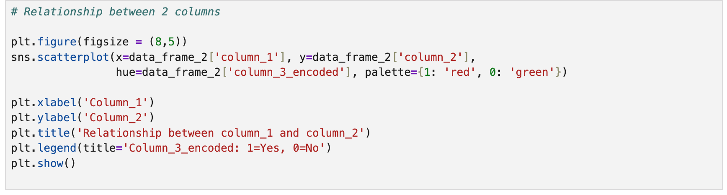
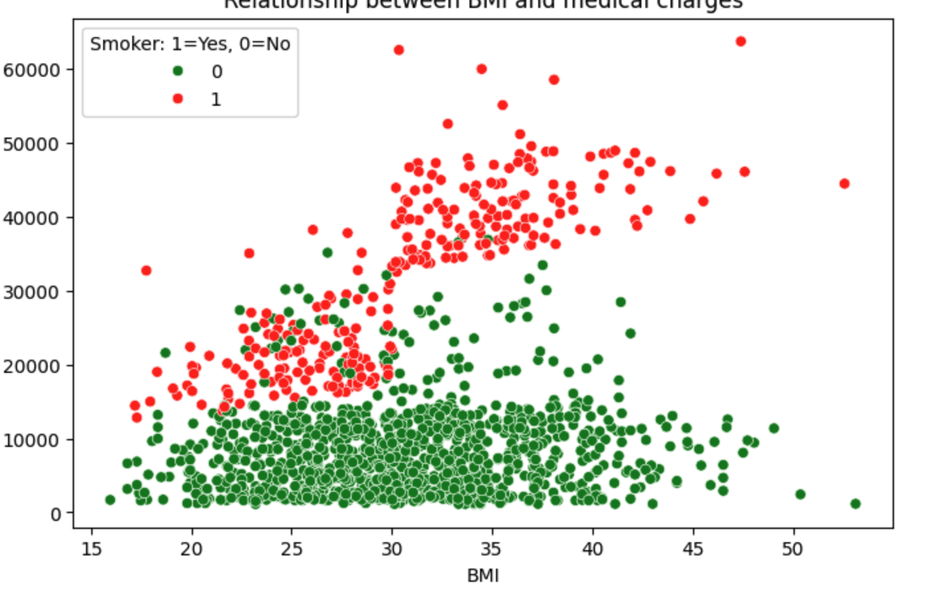
Relationship between column_1 and column_2
Column_3_encoded
Column_2
Column_1

Slide 24
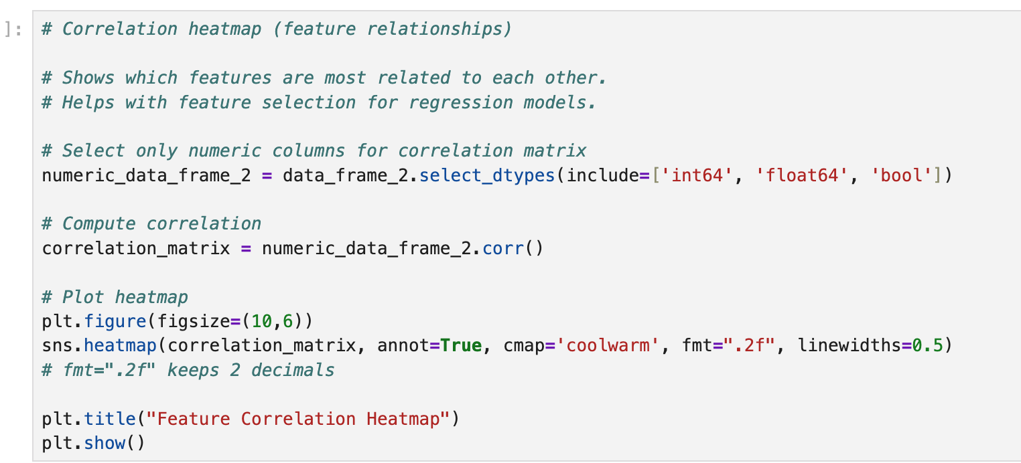
Your turn:
Show distribution of 3 features (3 graphs)
Show a relationship between 2 features
Shoe a correlation heatmap for all features
Comment on graphs

Slide 25
Exploratory Data Analysis (EDA) - Conclusion
Essential steps before aplying ML models;
Handling missing data ensures that model receives clean and complete dataset
This prevents biases and improves accuracy;
Visualization techniques provide insights into data distributions, relationships, and potential anomalies.
By combining these techniques, we can make decisions about feature engineering and model selection;
This improves quality of predictions.

Slide 26
Machine Learning Workflow
Raw Dataset
Feature extraction
Model Training
Predictions
Exploratory Data Analysis
Interpretation
Model Evaluation

Slide 27
Feature Extraction
Features are the input variables used by an ML model to make predictions.
Each feature represents a measurable characteristic of property of the data.
Usually, features represent columns in a table (if we have a structured dataset), where each row corresponds to a single data instance.
The quality and relevance of features play a crucial role in model performance.
Irrelevant or poorly chosen features can lead to inaccurate predictions.
Well-selected features improve accuracy and reliability.
Labels - Outcomes
Labels or target variables or dependent variables represent the correct outputs that an ML model aims to predict.
In supervised ML, labels are provided in the training data, allowing the model to learn the relationship between features and outcomes.
Classification has discrete labels and Regression has continuous labels.
Supervised learning output = the correct answer is known during training.

Slide 28
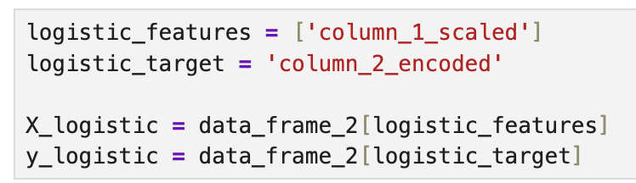
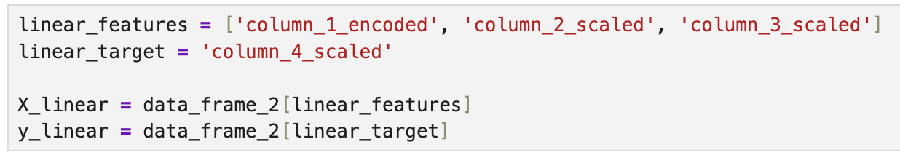
Feature Extraction
Your turn:
Extract features for Logistic Regression
Extract features for Linear Regression

Slide 29
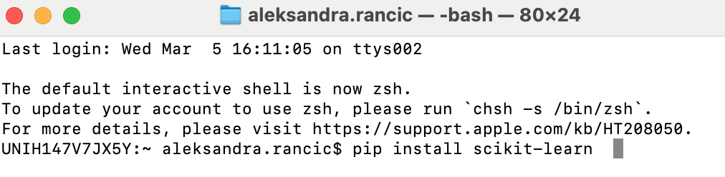
Splitting dataset and Scikit-learn
Scikit-learn is the most widely used ML library in Python;
Provides simple and efficient tools for: data mining and analysis, preprocessing, feature selection, model training and evaluation;
It also provides data transformation, normalization, and splitting datasets into training and testing sets.

Slide 30
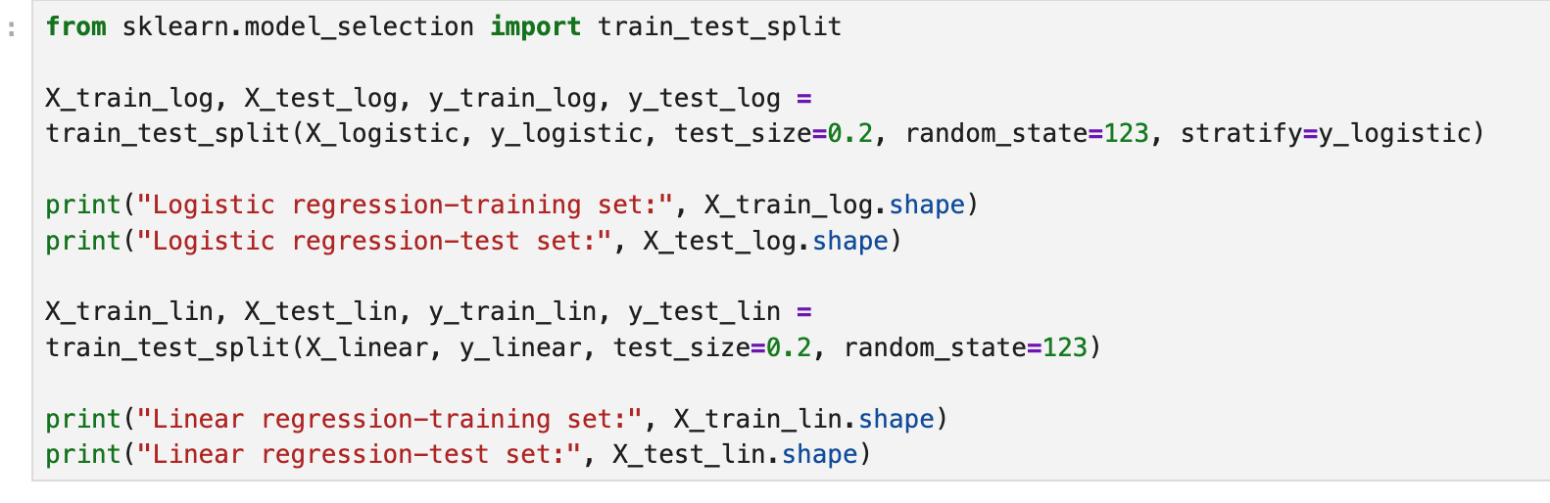
Splitting dataset and Scikit-learn
Your turn:
Split the dataset for Logistic Regression
Split the dataset for Linear Regression
Show the number of rows in train and test set

Slide 31
Machine Learning Workflow
Raw Dataset
Feature extraction
Model Training
Predictions
Exploratory Data Analysis
Interpretation
Model Evaluation

Slide 32
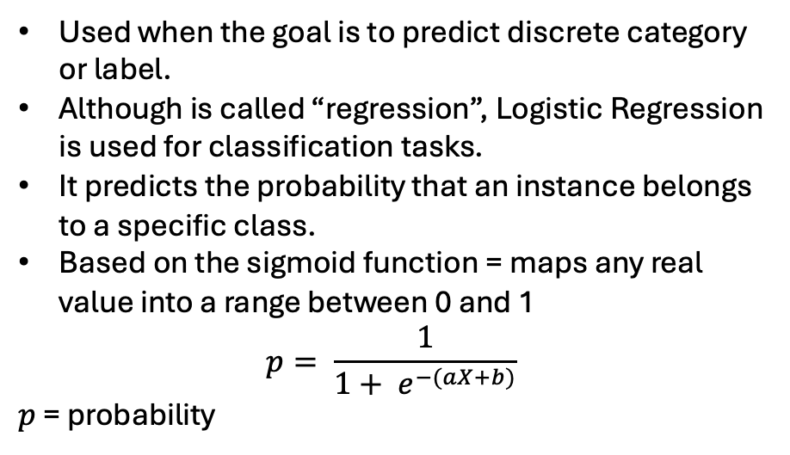
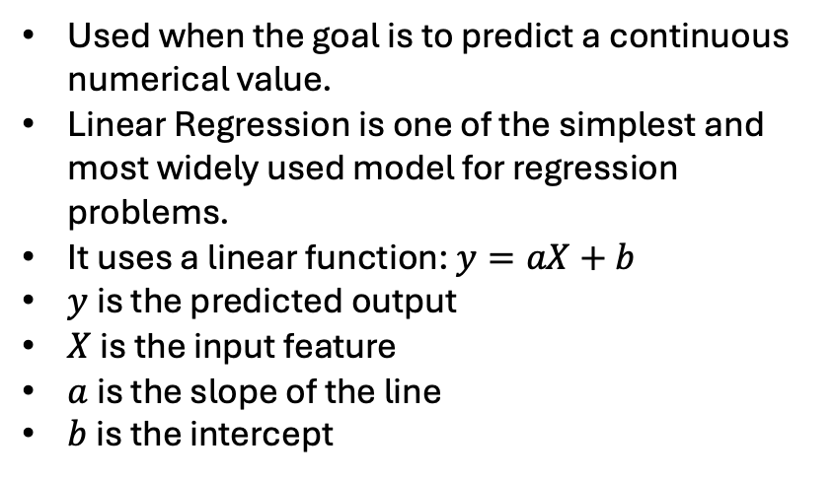
Supervised Learning – Regression vs. Classification
Regression
Classification
Used when the goal is to predict a continuous numerical value.
Linear Regression is one of the simplest and most widely used model for regression problems.
It uses a linear function: $y=aX+b$
$y$ is the predicted output
$X$ is the input feature
$a$ is the slope of the line
$b$ is the intercept
Used when the goal is to predict discrete category or label.
Although is called “regression”, Logistic Regression is used for classification tasks.
It predicts the probability that an instance belongs to a specific class.
Based on the sigmoid function = maps any real value into a range between 0 and 1
$$p= \frac{1}{1+ e^{−(aX+b)}}$$
$p$ = probability

Slide 33
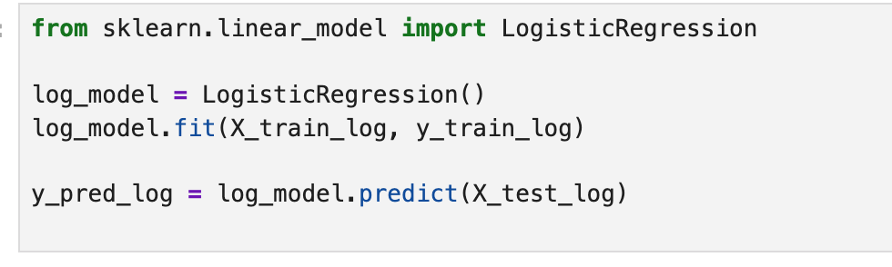
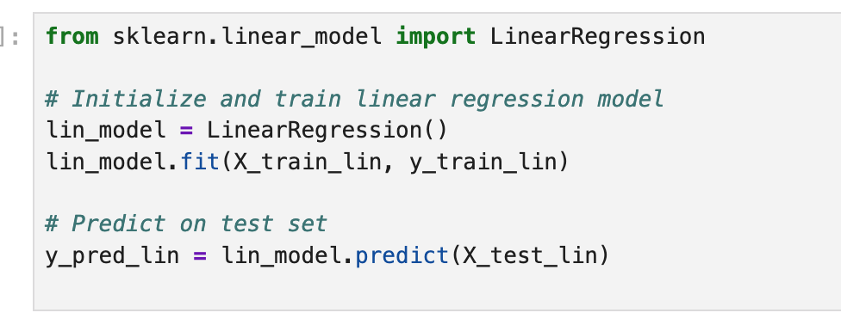
Logistic Regression & Linear Regression
Classification
Your turn:
Train Logistic Regression ML model on your dataset
Train Linear Regression ML model on the same dataset
Apply both models to make predictions
Regression

Slide 34
Machine Learning Workflow
Raw Dataset
Feature extraction
Model Training
Predictions
Exploratory Data Analysis
Interpretation
Model Evaluation

Slide 35
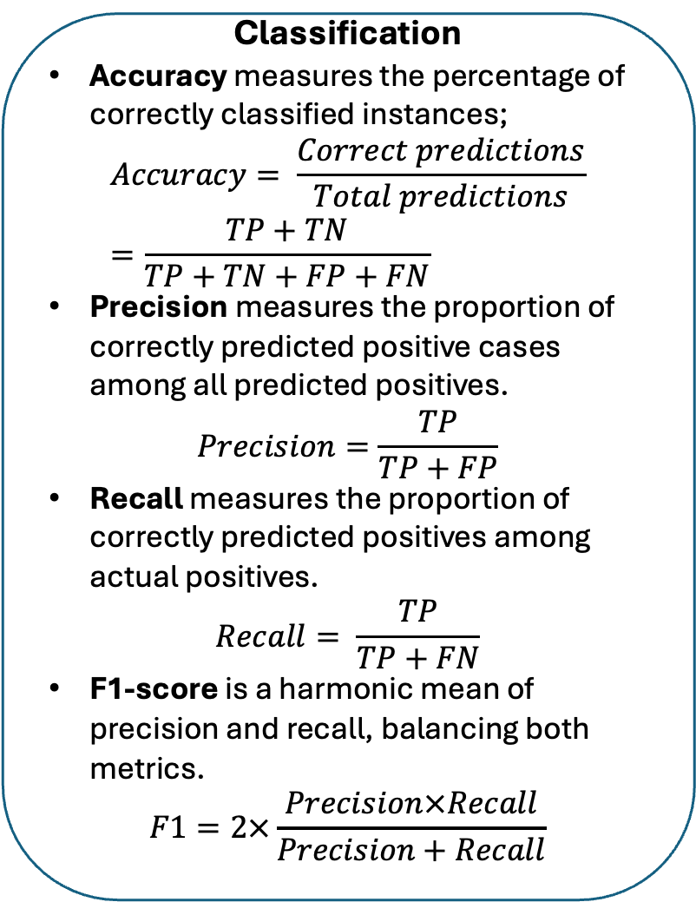
Model Evaluation & Interpretation
Confusion Matrix
Classification
Accuracy measures the percentage of correctly classified instances;
$$Accuracy= \frac{Correct predictions}{Total predictions}=\frac{TP+TN}{TP+TN+FP+FN}$$
Precision measures the proportion of correctly predicted positive cases among all predicted positives.
$$Precision=\frac{TP}{TP+FP}$$
Recall measures the proportion of correctly predicted positives among actual positives.
$$Recall= \frac{TP}{TP+FN}$$
F1-score is a harmonic mean of precision and recall, balancing both metrics.
$$F1=2×\frac{Precision×Recall}{Precision+Recall}$$
Actual \ Predicted | Predicted: No (0) | Predicted: Yes (1)
Actual: No (0) | True Negative (TN) | False Positive (FP)
Actual: Yes (1) | False Negative (FN) | True Positive (TP)
TP = Model correctly predicted Yes (1) when the actual values was Yes (1).
TN = Model correctly predicted No (0) when the actual value was No (0).
FP = Model incorrectly predicted Yes (1) when the actual value was No (0) (Type I error).
FN = Model incorrectly predicted No (0) when the actual value was yes (1) (Type II error).
A confusion matrix is a table that shows the performance of a classification model by comparing predicted vs. actual labels.

Slide 36
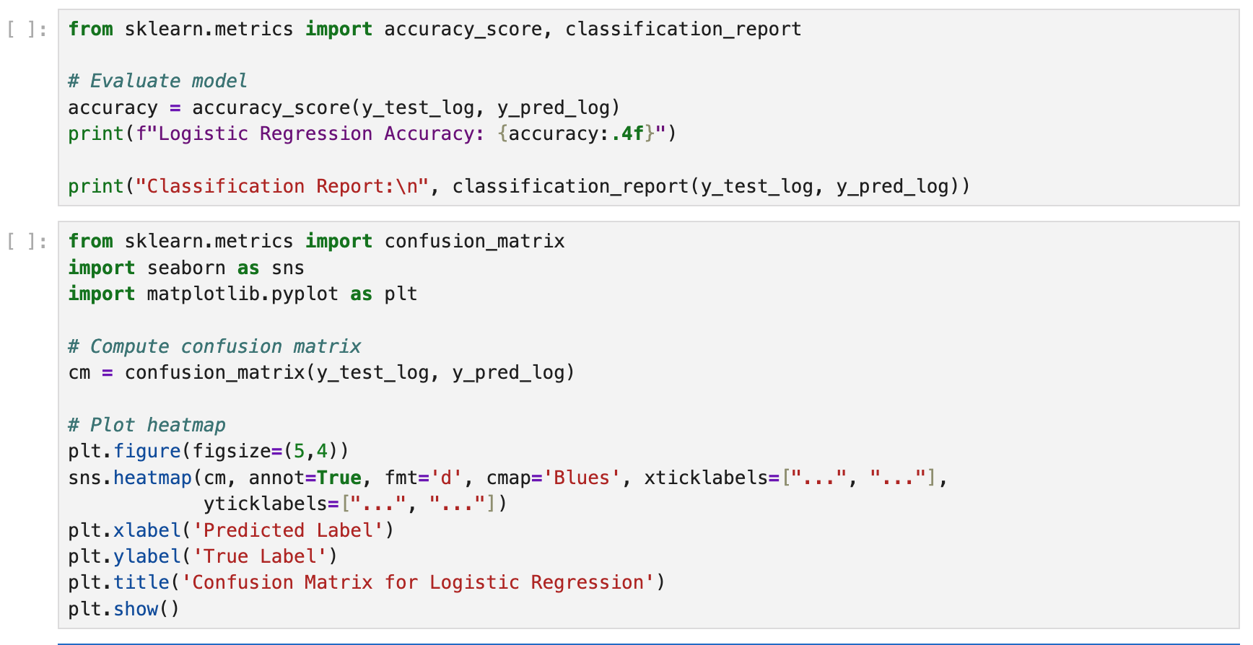

Slide 37
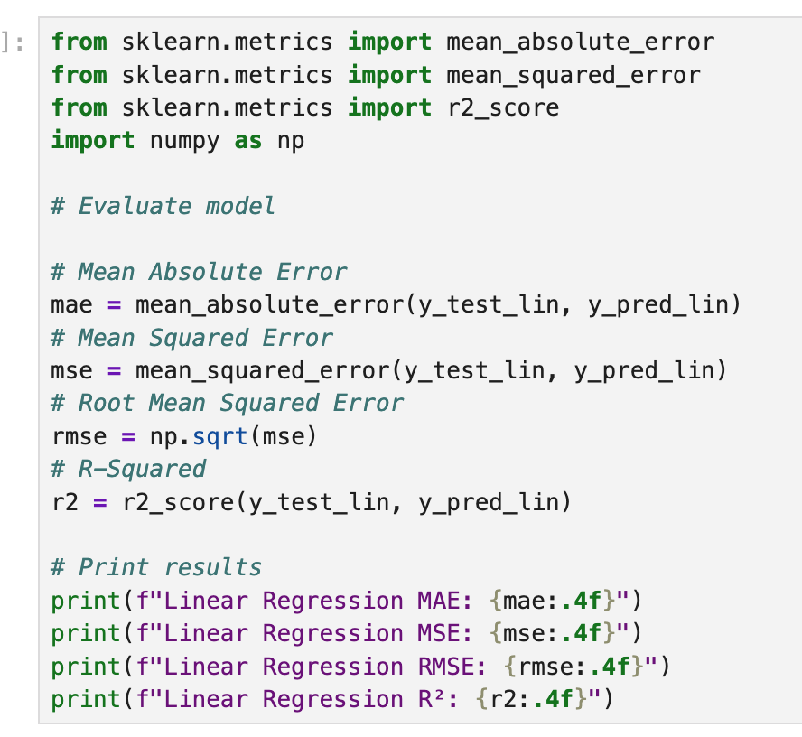
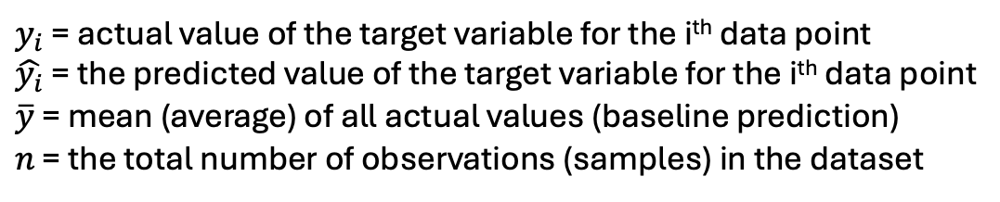
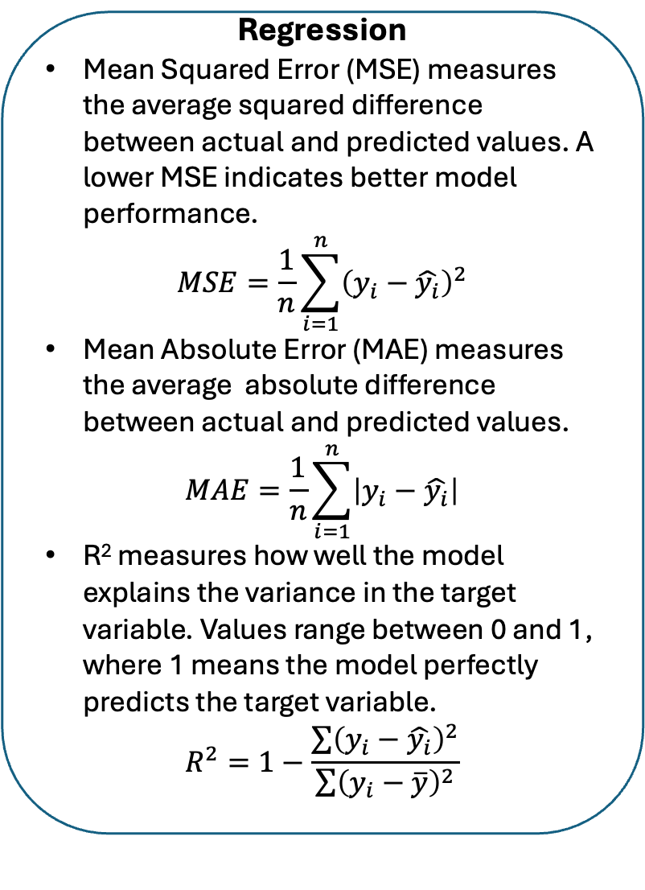
Model Evaluation & Interpretation
$y_{i}$ = actual value of the target variable for the i^{th} data point
$\hat{y_{i}}$ = the predicted value of the target variable for the i^{th} data point
$\overline{y}$ = mean (average) of all actual values (baseline prediction)
$n$ = the total number of observations (samples) in the dataset
Regression
Mean Squared Error (MSE) measures the average squared difference between actual and predicted values. A lower MSE indicates better model performance.
$$MSE=\frac{1}{n}\sum_{i=1}^{n}{{\left(y_{i}−\hat{y_{i}}\right)}^{2}}$$
Mean Absolute Error (MAE) measures the average absolute difference between actual and predicted values.
$$MAE=\frac{1}{n}\sum_{i=1}^{n}{\left|y_{i}−\hat{y_{i}}\right|}$$
R² measures how well the model explains the variance in the target variable. Values range between 0 and 1, where 1 means the model perfectly predicts the target variable.
$$R^{2}=1−\frac{\sum{{\left(y_{i}−\hat{y_{i}}\right)}^{2}}}{\sum{{\left(y_{i}−\overline{y}\right)}^{2}}}$$
Your turn:
Evaluate Logistic regression model
Show Confusion Matrix for Logistic Regression
Evaluate Linear Regression model
Comment on the results

Slide 38
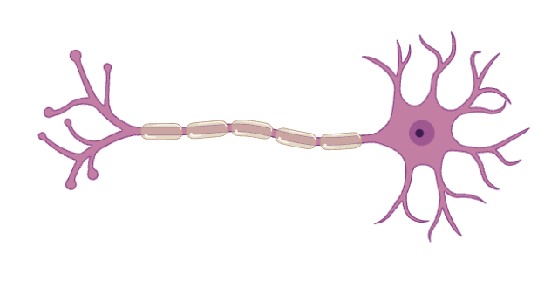
Introduction to Neural Networks
Neural Networks are the building blocks of deep learning systems.
How do our brains subconsciously perform complex pattern recognition tasks each and every day?
We have a real-life biological neural network connected to our nervous systems, and it is made up of interconnected neurons.
Terminal buttons (connections to other neurons)
Dendrite (inputs)
Axon (outputs)
Nucleus (activation function)
Myelin sheath
Soma (cell body – neuron
computation; weighted sum + activation)
Human neural cell - neuron
Artificial Neural Network is a computation system that attempts to mimic the neural connection in our nervous system.

Slide 39
A Neural Network (NN) is like a connected system of points, where:
Each point (called a node or neuron) does a small calculation;
The connections (called edges) between them show which nodes send information to others.
The connections have directions –information flows from one node to the next.
This forms a directed graph – a structure made of connected parts where data flows in one direction.
For something to be called a NN, it needs:
Nodes that do calculations
Connection showing how data flows
A structure that connects everything in layers
Neural networks are built using concepts from graph theory;
They are directed graphs where nodes (neurons) do computations and edges (connections) carry weighted signals;

Slide 40
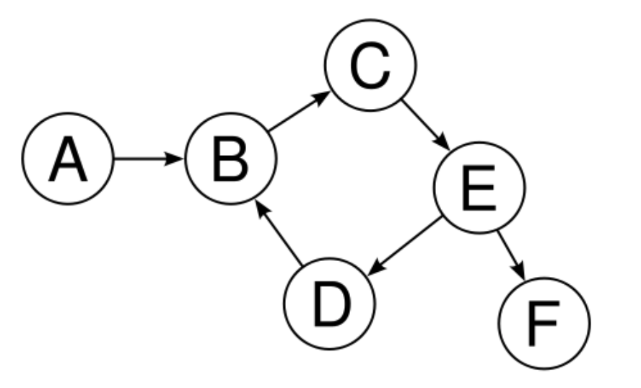
A graph is like a map of connections having:
Nodes (vertrices) and
Edges (or links, connections)
Input
This is a classic feedforward neural network structure
Output
Hidden layers

Slide 41
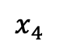
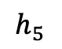
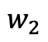
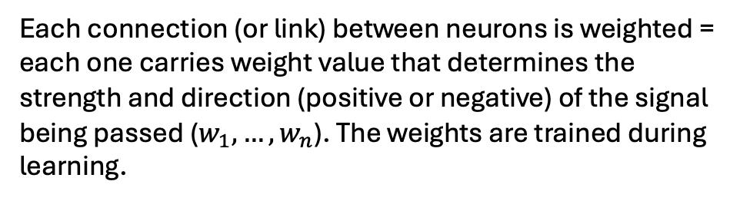
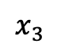
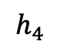
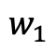
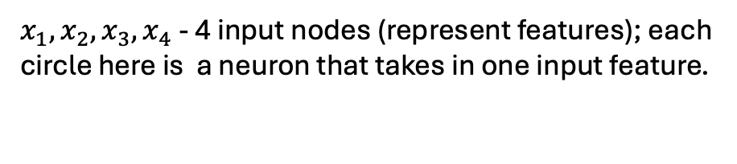
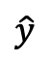
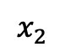
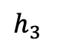
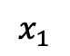
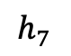
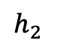



Input
$x_{1}, x_{2},x_{3},x_{4}$ - 4 input nodes (represent features); each circle here is a neuron that takes in one input feature.
$$x_{1}$$
$$w_{1}$$
$$h_{1}$$
Each input node is connected to one square, showing 1:1 mapping
$$w_{2}$$
$$h_{5}$$
$$x_{2}$$
$$h_{2}$$
Output
Each connection (or link) between neurons is weighted = each one carries weight value that determines the strength and direction (positive or negative) of the signal being passed ($w_{1}, …, w_{n}$). The weights are trained during learning.
$$h_{6}$$
$$\hat{y}$$
$$x_{3}$$
$$h_{3}$$
$$h_{7}$$
$$h_{4}$$
$$x_{4}$$
The squares in the first layer can represent the weighted inputs or intermediate neurons (weighted units or projection from input to deeper layers; $h_{1}, …, h_{4}$).
Hidden layers
The third column – the second hidden layer – three squares form a true hidden layer, where each node receives input from multiple previous nodes. In this layer, complex combinations of features are learned.
A multi-layer feedforward neural network
Output layer = the final prediction/output node, which gives the final results

Slide 42



Input
Each node ($x_{n}$) performs a simple computations.
Each connection carries a signal, or the output of the computation from one node to another ($h$).
Each connection is labeled by weight ($w_{1}$) indicating the extent to which the signal is amplified or diminished.
$$x_{1}$$
$$w_{1}$$
$$h_{1}$$
$$w_{2}$$
$$h_{5}$$
$$x_{2}$$
$$h_{2}$$
Output
$$h_{6}$$
$$\hat{y}$$
$$x_{3}$$
$$h_{3}$$
$$h_{7}$$
$$h_{4}$$
$$x_{4}$$
$$h=f\left(\sum{\left(w_{i}x_{i}\right)}+b\right)=f(net)$$
Hidden layers
A multi-layer feedforward neural network
$b$ – bias, a constant – a trainable value
$f$ – activation function

Slide 43







Activation functions
1. Step function
$$f\left(x\right)= \left\{\begin{aligned}1, x≥0 \\ 0, x<0 \end{aligned}\right.$$
1
2
2. Sigmoid function
$$f\left(x\right)=\frac{1}{1+e^{−x}}, f\left(x\right)∈(0,1)$$
3. Tanh function
$$f\left(x\right)=\tanh\left(x\right)= \frac{e^{x}−e^{−x}}{e^{x}+e^{−x}},$$
$$f\left(x\right)∈(−1,1)$$
3
4
4. ReLU function
$$f\left(x\right)=\left\{\begin{aligned}x, x>0 \\ 0, x≤0\end{aligned}\right.$$
5. Leaky ReLU function
$$f\left(x\right)=\left\{\begin{aligned}x, x>0 \\ αx, x≤0\end{aligned}\right.$$
5
6
6. ELU function
$$f\left(x\right)=\left\{\begin{aligned}x, x>0 \\ α(e^{x}−1), x≤0\end{aligned}\right.$$

Slide 44




Activation functions
1. Step function
$f\left(x\right)= \left\{\begin{aligned}1, x≥0 \\ 0, x<0 \end{aligned}\right.$, rarely used
2. Sigmoid function
$f\left(x\right)=\frac{1}{1+e^{−x}}, f\left(x\right)∈\left(0,1\right)$ ; When you want a probability between 0 and 1
3. Tanh function
$f\left(x\right)=\tanh\left(x\right)= \frac{e^{x}−e^{−x}}{e^{x}+e^{−x}},$ used in hidden layers
$f\left(x\right)∈(−1,1)$
4. ReLU function
$f\left(x\right)=\left\{\begin{aligned}x, x>0 \\ 0, x≤0\end{aligned}\right.$ default choice for hidden layers in most deep neural networks; good for CNN;
5. Leaky ReLU function
$f\left(x\right)=\left\{\begin{aligned}x, x>0 \\ αx, x≤0\end{aligned}\right.$ Alternative to ReLU, when training is slow or ReLU seems unstable
6. ELU function
$f\left(x\right)=\left\{\begin{aligned}x, x>0 \\ α(e^{x}−1), x≤0\end{aligned}\right.$ For deep networks where faster and more stable training is needed;

Slide 45















Input
$$x_{1}$$
$$w_{1}$$
This type of neural network with multi layers has forward propagation;
Forward propagation is computationally straightforward;
Poor predictions, since the weights and biases are randomly initialized;
$$h_{1}$$
$$w_{2}$$
$$h_{5}$$
$$x_{2}$$
$$h_{2}$$
Output
$$h_{6}$$
$$\hat{y}$$
$$x_{3}$$
$$h_{3}$$
$$h_{7}$$
$$h_{4}$$
$$x_{4}$$
Hidden layers
$$h=f\left(\sum{\left(w_{i}x_{i}\right)}+b\right)=f(net)$$

Slide 46

Backward propagation – learning from errors
This is one EPOCH
Steps:
We compute the predicted output (as previously described):
$$z=\sum{w_{i}x_{i}+b}$$
$$\hat{y}=activation\left(z\right)$$
Calculate the Loss ($L$, error): the difference between the predicted output and the actual target value; calculated using a loss function (e.g., Mean Squared Error, Cross-Entropy,….)
$L=\frac{1}{2}{\left(y−\hat{y}\right)}^{2}$ OR $L=−\left[y∙\log\left(\hat{y}\right)+(1−y)∙log⁡(1−\hat{y})\right]$ OR …
Backward Pass – compute Gradients:
$\frac{∂L}{∂w_{i}}=\frac{∂L}{∂\hat{y}}∙\frac{∂\hat{y}}{∂z}∙\frac{∂z}{∂w_{i}}$; Where, $\frac{∂z}{∂w_{i}}=x_{i}$
Update weights:
$w_{i}^{new}=w_{i}^{old}−α∙\frac{∂L}{∂w_{i}}$; where $α$ – learning rate;
Repeat for all training data

Slide 47

Neural Networks – A Multi-Level Perceptron
Forward propagation
Backward propagation
Input Layer
Hidden Layer 1
Hidden Layer 2
Output Layer

Slide 48
Neural Networks – Conclusion
Forward and Backward propagation are the foundation of training Deep Learning models.
Forward propagation allows the network to make predictions.
Backward propagation fine-tunes the network to improve accuracy.
Together, they enable neural networks to learn from data and generalize to unseen examples.

